Slide 1

alary
Prediction
Income prediction - using decision tree
Grace Palma

Slide 2

Problem
Most valuable question in Market research:
Personal income
Potential spending habits
Discretionary income
Audience segregation
Product or campaign targeting

Slide 3


Background
ABS census: Mean yearly personal income
$80,000 +
Aim
To predict if a person earns above or below the average salary for Australians

Slide 4
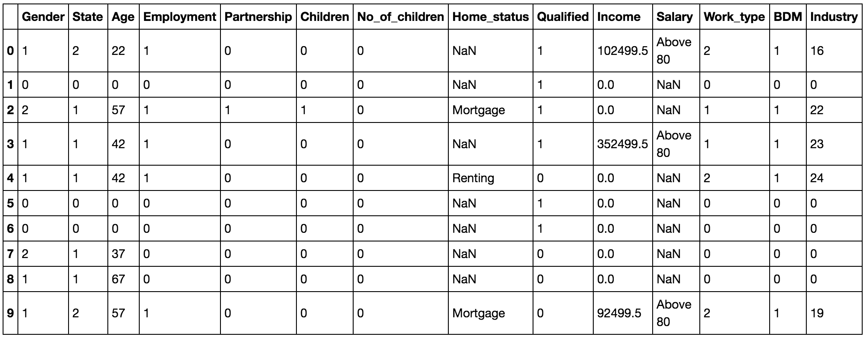

Data
Survey data
Online panel
Contains information on an individual’s relationship status, work related information, etc.

Slide 5

Tools
from sklearn import tree
import pandas as pd
import numpy as np
import math
Visualisation:
import matplotlib.pyplot as plt
import seaborn as sns
%matplotlib inline
Change categorical to numerical:
for c in features_categorical:
df[c] = pd.Categorical(df[c]).codes
Model classifier:
from sklearn.tree import DecisionTreeClassifier
Accuracy test:
from sklearn.metrics import roc_auc_score

Slide 6
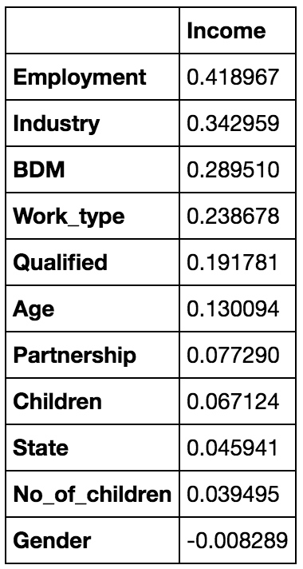
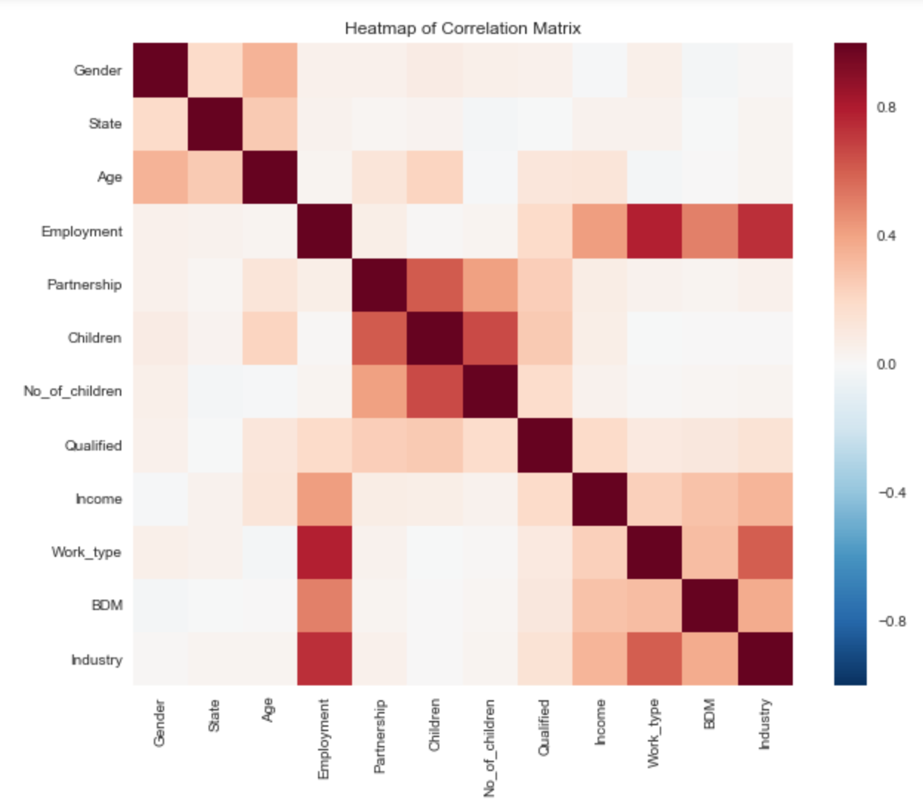
Feature
selection
Correlation matrix
Heatmap of correlation matrix

Slide 7
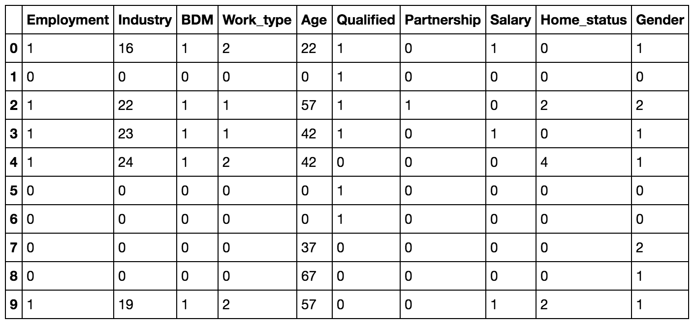
Pre-
processing
Define relevant variables or features
Define categorical variables
Change categorical variables to numeric
Define features
Define target

Slide 8

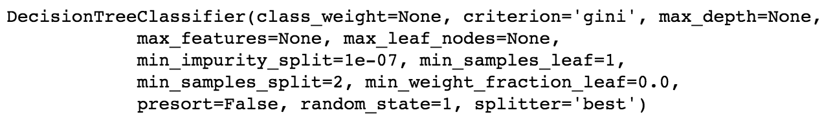
Analysis
Split and train the data set
80% for training
20% for testing
DecisionTreeClassifier from scikit learn package to fit the decision tree

Slide 9
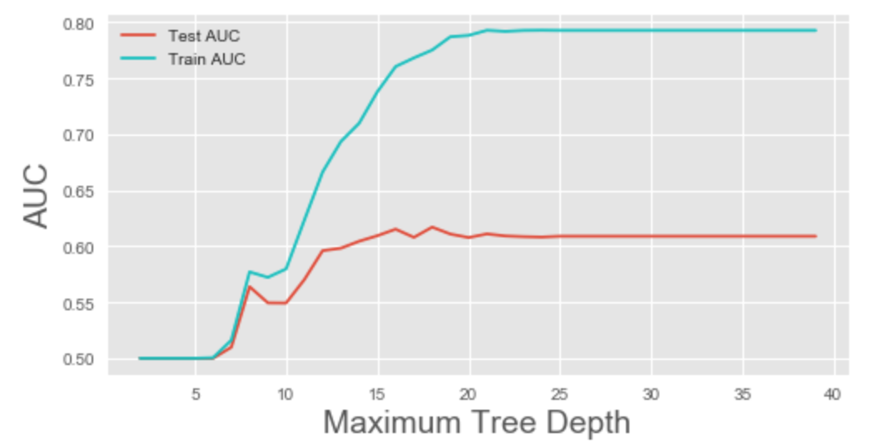
Accuracy
test
Area under the curve
Test: 0.608960029048
Training: 0.792767534575
Tree depth restrictions

Slide 10
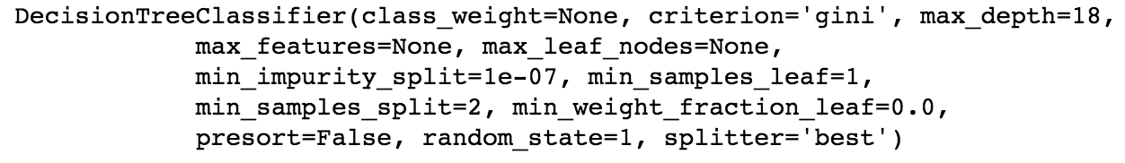
Tree depth
restrictions
Depth restricted to 18
Area under the curve
Test: 0.617106179584
Training: 0.775251922562

Slide 11

Applications
& next steps
Applications
Consumer profiling
Predict other information EG Education
Next steps
Find variables that can render better salary predictions
...

